Slide 1
Name of session
This session will start at __:__
While you are waiting…
Check your audio is working
Plug in your speakers/ headphones before you start the session.
If you cannot hear your tutor, leave the session and log back in again.
If you still cannot hear, let your tutor know by writing them a message in the chat box.
If you are still experiencing problems
Try disconnecting and reconnecting your PC/laptop to the internet.
Call 0345 074 7958 to speak to the QAHE Online Learning support team.
You can also email the team on QAHEOnlineLearning@qa.com
Notes:
You should start your session 15 to 30 minutes before the start time.
The learners should be greeted with this slide: remember to adapt to fit your time.

Slide 2
Session etiquette
Notes:
Prepare your students to interact during the session.

Slide 3
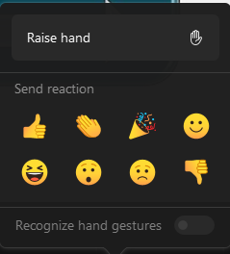

Session etiquette
You’ll be asked to respond/interact throughout this session. So, be ready to:
Raise your hand
React by selecting emoji

Slide 4
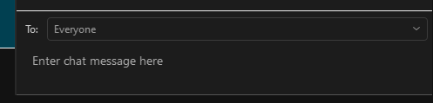
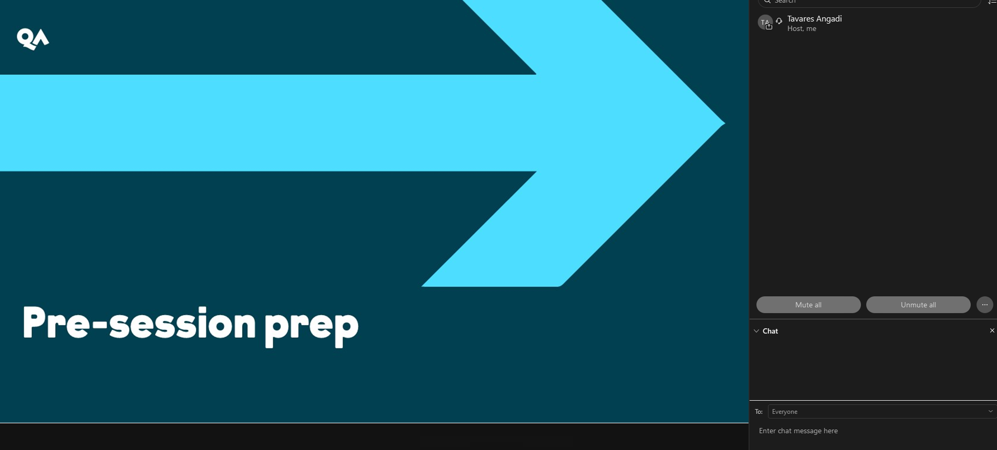
Session etiquette
…or respond via the chat box…

Slide 5
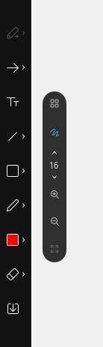
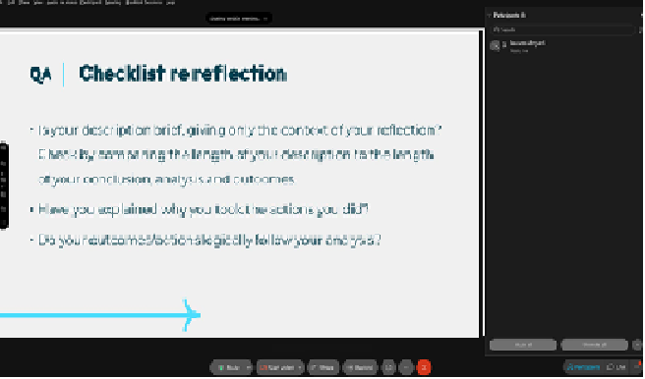
Session etiquette
You may also be asked to annotate, but this option is unfortunately not available via mobile devices:

Slide 6

We are recording now!
This session will be recorded and shared with all students following the session. Any personal data captured during the recording will be processed and retained in accordance with the QA Higher Education Privacy Notice which can be found on the QAHE website
Notes:
This will alert the learners to the fact you are recording and remind you to start recording!

Slide 7
Introduction to UX Strategy
Week 1 lecture | UX Strategies

Slide 8
A Quick Discussion…
Raise your hand to answer verbally, or write your ideas in the chat box:
What is the difference between UX and UI?
Give an example
Who would like a career in UX design?
What is the expected salary range of UX designers today?
Remember:
UX Designers are NOT UI Designers!

Slide 9
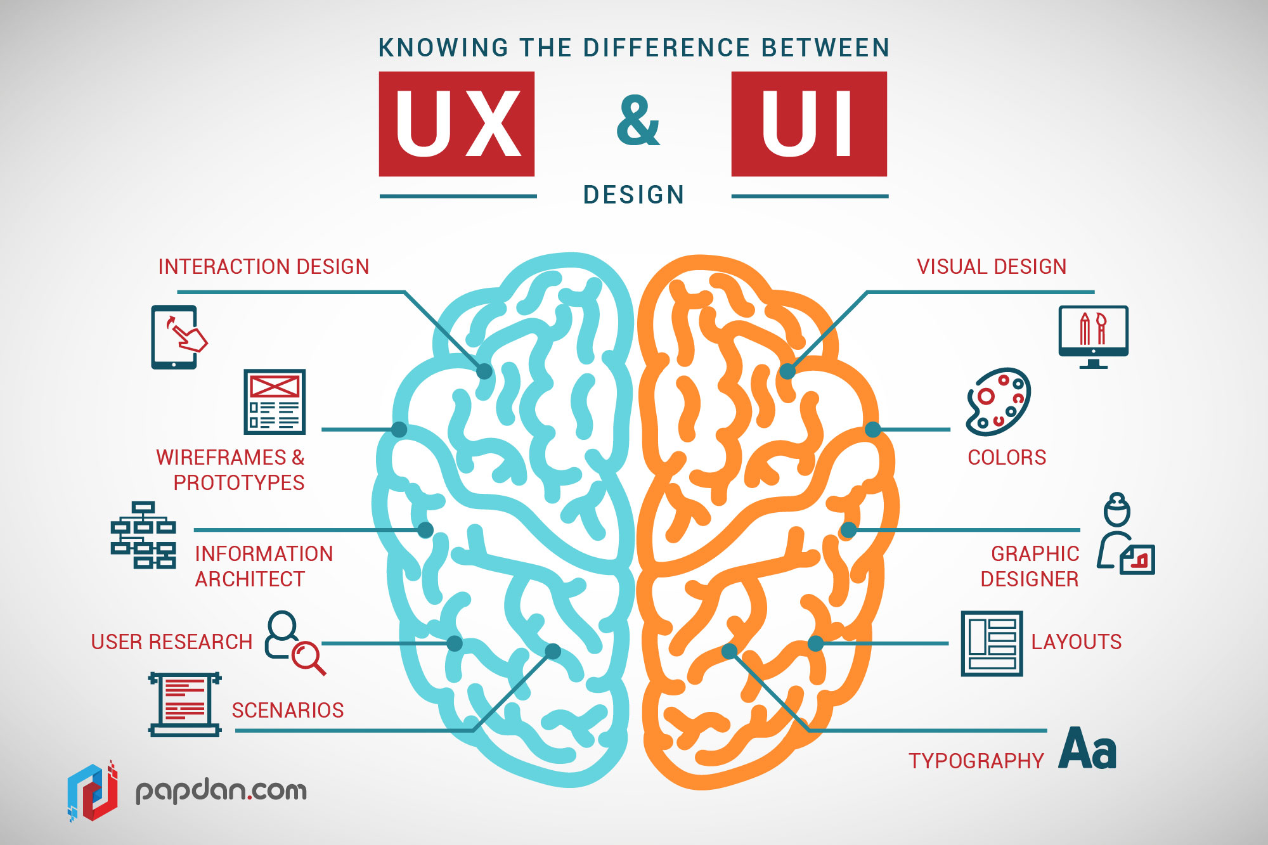
Differences between UI and UX Design (1)
(Papdan.com cited in Weerasinghe 2018)
Notes:
References: https://www.interaction-design.org/literature/article/ux-vs-ui-what-s-the-difference
Focus:
UX: Emphasizes the user's journey to solve a problem and the overall feel of the product.
UI: Focuses on the product's visual and interactive elements.
Outcome:
UX: Aims for a seamless, efficient, and enjoyable experience for the user.
UI: Strives for a visually appealing and engaging interface.
Process:
UX: Involves research, wireframing, prototyping, and testing.
UI: Involves designing the aesthetics and interactive elements after the UX phase.

Slide 10
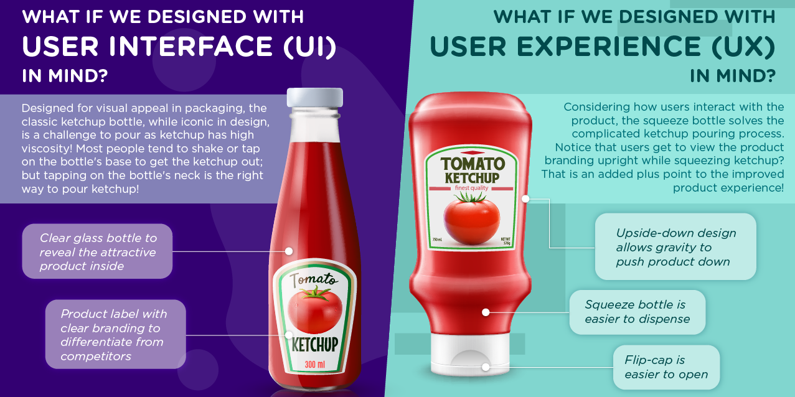
Differences between UI and UX Design (2)
(skillsfuture 2021a)
Notes:
The ketchup bottle analogy
This is the classic example that you’ll find. A glass ketchup bottle vs the squeezable version. One is clearly much easier to use than the other, thus people say that the squeezable one represents UX because clearly, someone investigated how people used the glass bottle and realised that smacking it to get your ketchup wasn’t optimal.
Why the glass bottle represents the UI, well that is beyond me, and that’s where my annoyance starts.
Although there was probably research that triggered the appearance of the squeezable ketchup container, the other part of the story is that it was introduced as technological innovation, because before that it wasn’t possible to produce such containers. Comparing these 2 things is the same as if you compare the first iPhone against one of the latest ones.
UI is part of UX
As you probably already know, UX stands for User Experience and UI for User Interface. Putting these two things against each other implies that they can live independently which is not the case.
The user experience is the result of their interaction with a product or service, which means that user experience includes, but is not limited to, a user interface. The UI is one of the contributing factors for the end user experience.
References: https://medium.com/lfdev-blog/you-developer-unconsciously-uses-any-part-of-the-ux-ui-design-24439a4f89e3
https://www.youtube.com/watch?v=6chQ6JZpvTQ
UX/UI Case Study:https://www.dandad.org/awards/professional/2024/238365/ketch-up-down/

Slide 11
Session Outcomes
Learning Outcome 1: Identify the key components of User Experience context, including understanding the technology and stakeholders.
Learning Outcome 2: Explain usability and effectiveness of digital products and services and to identify UX Strategies examples through case study.
Notes:
Let’s begin today’s lecture on the above learning outcomes.

Slide 12
Topic 1:
UX Strategies

Slide 13
UX Strategies - Subtopics
This week’s Lecture will contain one large topic, covering the following sub-topics:
  Design Thinking
  Components of UX Strategy
  Applicability of UX through 4D Model
  Retail Company Case study
  Ecommerce Website Case Study

Slide 14
Definition
Write a short definition of UX strategy in your own words. Type it in the chat box, but don't press send until the lecturer gives the instruction. You have 2 minutes.
Definition of UX Strategy: UX strategy defines the approach to creating products that offer meaningful and relevant experiences to users. It encompasses the entire user experience, from the initial interaction to the final use.
(Soegaard 2024a)
Importance of UX Strategy in the Modern Business Context: Differentiates brands in a competitive market. Enhances user satisfaction and loyalty. Drives business growth through improved user engagement and retention.
(Soegaard 2024a)
Notes:
https://www.interaction-design.org/literature/article/learn-from-ixdf-design-thinking-course
Show question first, before showing answer.

Slide 15
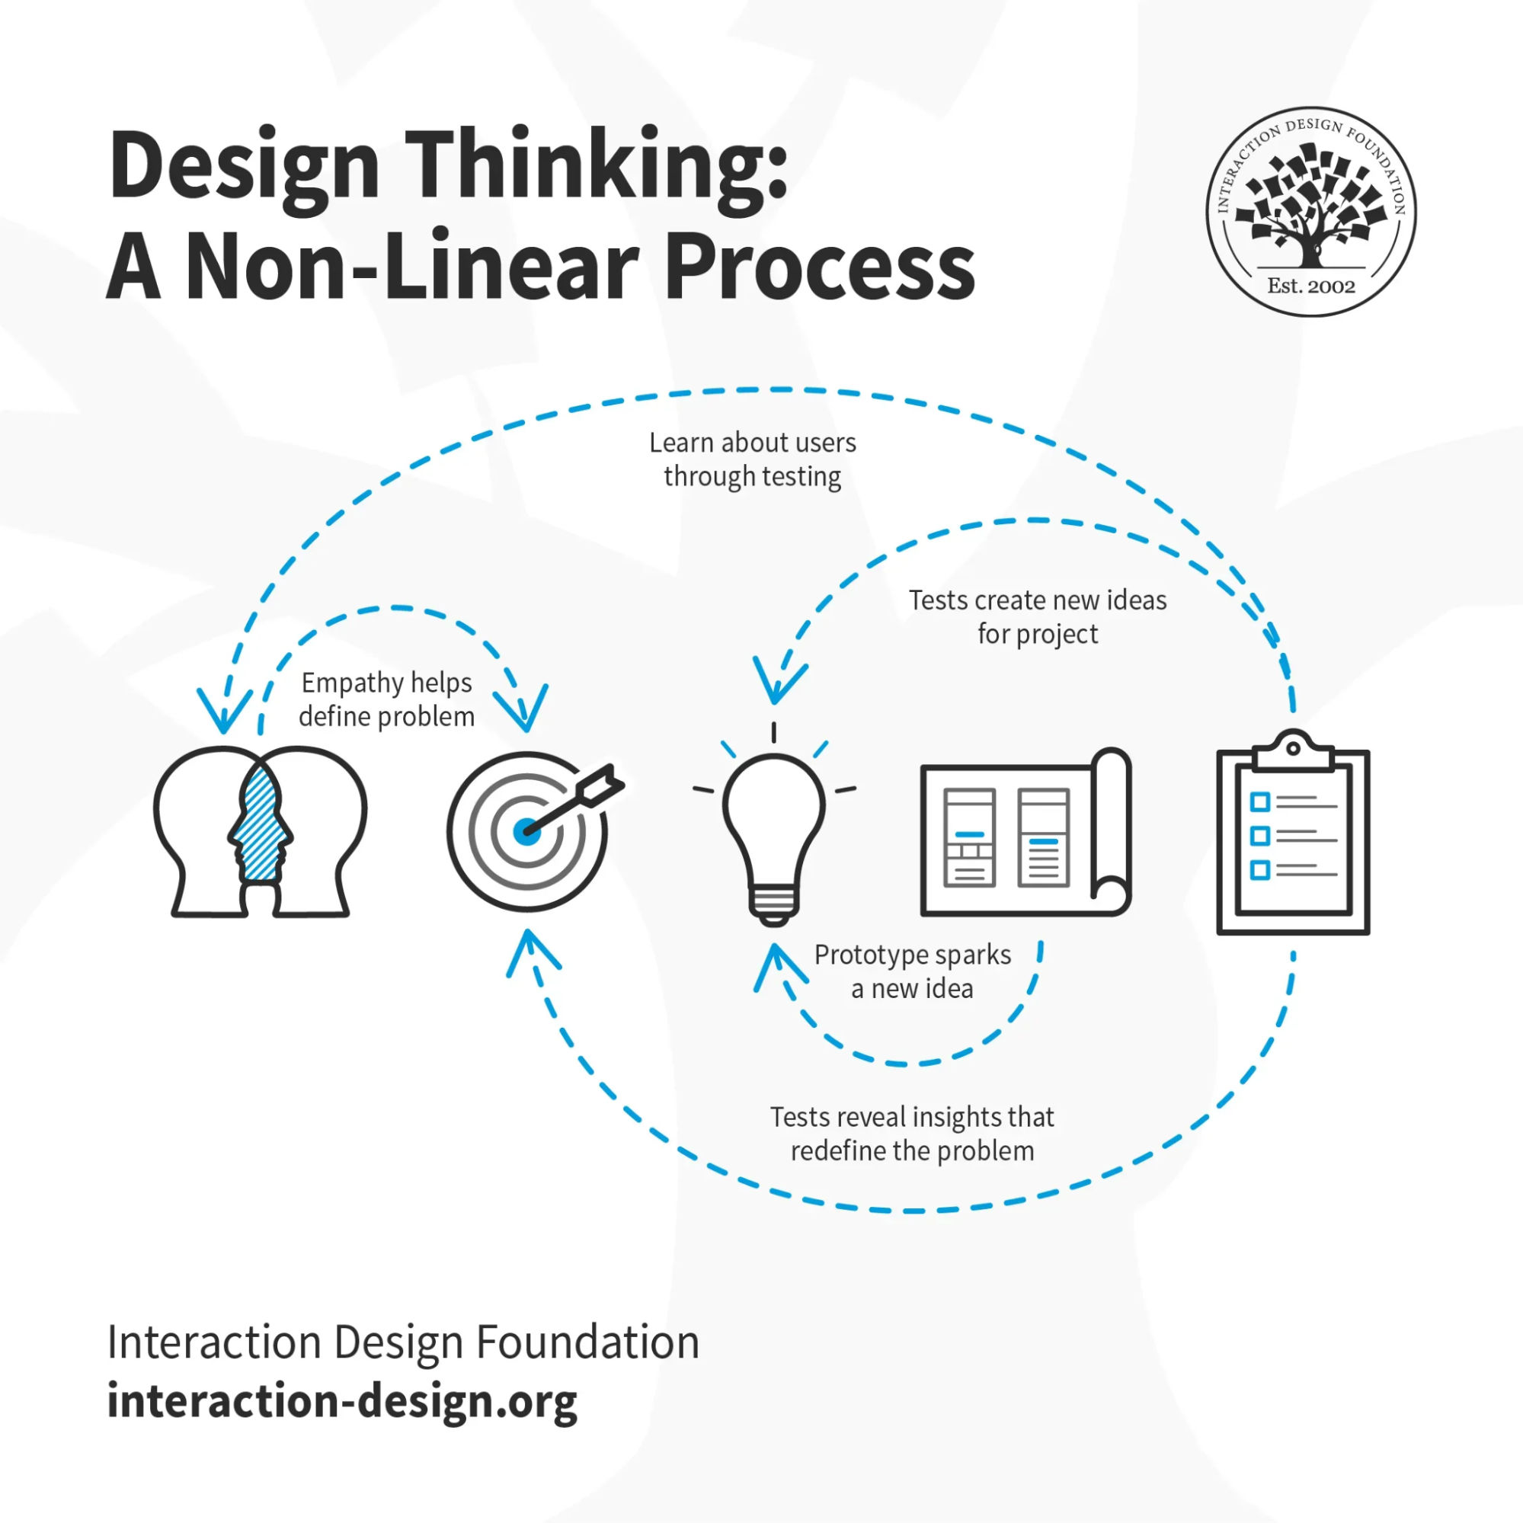
What is Design Thinking? (1)
Design thinking is an iterative, non-linear process teams use to understand users, challenge existing assumptions, redefine problems and craft innovative solutions they prototype and test.
You can use it to tackle complex or undefined problems.
The process comprises five key phases: Empathize, Define, Ideate, Prototype and Test. (IdxF 2024)
(Soegaard 2024)
Notes:
What is Design Thinking?
Reference: https://www.interaction-design.org/literature/article/learn-from-ixdf-design-thinking-course
https://www.interaction-design.org/literature/topics/empathize

Slide 16
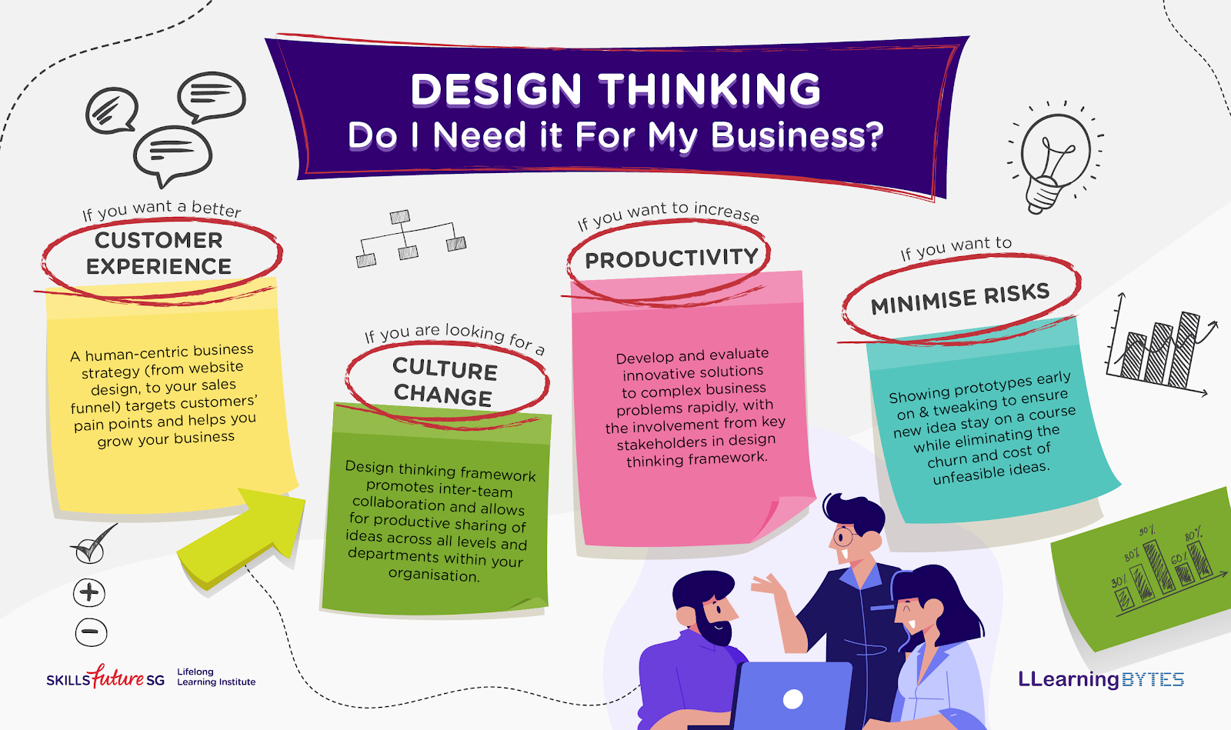
What is Design Thinking? (2)
(skillsfuture 2021b)

Slide 17
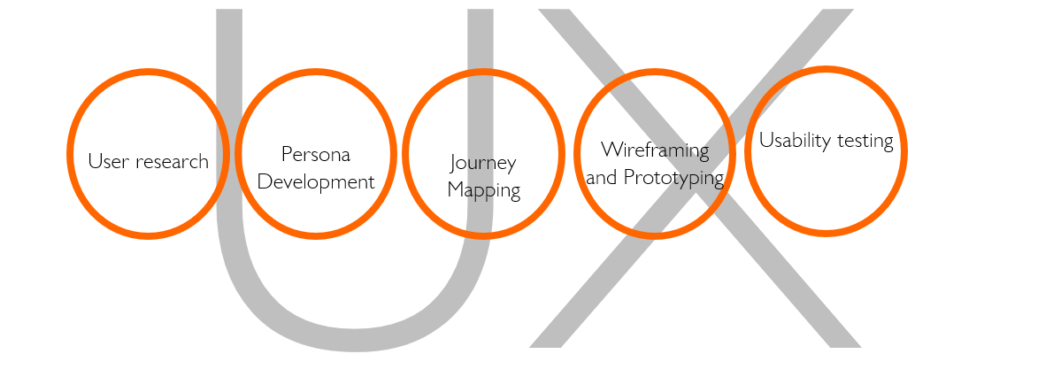
Components of UX Strategy
(Patel 2023)
Notes:
•User Research: Gathering insights into user behaviors and needs.
•Persona Development: Creating representative user profiles.
•Journey Mapping: Visualizing the user's interactions with the product.
•Wireframing and Prototyping: Designing preliminary layouts and interactive models.
•Usability Testing: Evaluating the product's ease of use.
https://neilpatel.com/blog/content-marketing-trends/

Slide 18
4D Model Applicability of UX Plan Process
Discovery
Definition
Design
Development
Discover: Understanding user needs and market demands through research and data analysis. Tools: Surveys, interviews, analytics.
Define: Creating a clear project scope and objectives based on user insights. Tools: Personas, journey maps, user stories.
Design: Developing wireframes, prototypes, and UI designs. Tools: Sketch, Figma, Adobe XD.
Deliver: Implementing and testing the final product to ensure usability and satisfaction. Tools: Usability testing, A/B testing, user feedback.
(Pacheco 2021)
Notes:
•Discover: Understanding user needs and market demands through research and data analysis. Tools: Surveys, interviews, analytics.
•Define: Creating a clear project scope and objectives based on user insights. Tools: Personas, journey maps, user stories.
•Design: Developing wireframes, prototypes, and UI designs. Tools: Sketch, Figma, Adobe XD.
•Deliver: Implementing and testing the final product to ensure usability and satisfaction. Tools: Usability testing, A/B testing, user feedback.
Pacheco, J.F. (2021). Design Thinking the 4D UX methodology. [online] Juan Fernando Pacheco. Available at: https://medium.com/juanpacheco/design-thinking-the-4d-ux-methodology-e621adc3339c

Slide 19
4D Model – The Plan Process (1)
Discovery
Definition
Design
Development
Stakeholder Interviews
Business Requirements
Competitive/Comparative Audit
User Research
Site Inventory
Site Map

Slide 20
4D Model – The Plan Process (2)
Discovery
Definition
Design
Development
Personas
Content Audit
Card Sorts
Use Cases
Sketching
Site Map
User Journeys
Conceptual Wires/Design
Creative Brief
UX Brief

Slide 21
4D Model – The Plan Process (3)
Discovery
Definition
Design
Development
Site Map
Content Matrix
Task Flows
Sketching
Wireframes
Stakeholder Reviews
Virtual Design
Prototype
Usability Testing
Functional Specifications

Slide 22
4D Model – The Plan Process (4)
Discovery
Definition
Design
Development
Site Development
User Acceptance Testing (UAT)
Quality Assurance (QA)
Usability Testing

Slide 23
Agile UX vs. Lean UX
(Pacheco, 2021)
Discovery
Definition
Design
Development
Stakeholder Interviews
Business Requirements
Competitive/Comparative Audit
User Research
Site Inventory
Site Map
Personas
Content Audit
Card Sorts
Use Cases
Sketching
Site Map
User Journeys
Conceptual Wires/Design
Creative Brief
UX Brief
Site Map
Content Matrix
Task Flows
Sketching
Wireframes
Stakeholder Reviews
Visual Design
Prototype
Usability Testing
Functional Specifications
Site Development
User Acceptance Testing (UAT)
Quality Assurance (QA)
Usability Testing
Notes:
The slides shows that you don’t have to follow each and every activity in the process. In agile we only pick some of the activities according to business problems.
https://www.toastdesign.co.uk/services/leaflet-designers/

Slide 24
Case Study 1:
An Ecommerce Website

Slide 25

Case Study 1 – An Ecommerce Website
Problem Overview:
  Website: ExampleShop.com
  Issue: Customers are abandoning their carts at a high rate during the checkout process.
  Impact: Decreased conversion rates. Lost revenue. Negative customer perception.
What are the possible causes of the issue and what other impacts could it cause? Raise your hand to speak or write your ideas in the chat box.
Notes:
For lecturers:Discuss this case study in detail keeping in mind the problem and its solution through UX Strategy

Slide 26
Case Study 1 – Identified Issues
Complex Navigation: Multiple steps required to complete the purchase. Difficult to find and apply discount codes.
Poor Mobile Experience: Checkout process not optimized for mobile devices. Small buttons and text, hard to use on smaller screens.
Lack of Trust Signals: No visible security badges or payment guarantees. Users unsure about the safety of their personal and payment information.

Slide 27

Case Study 1 – Detailed Analysis
•Complex Navigation: Issue: The checkout process requires navigating through multiple pages and filling out extensive forms. Impact: Increased abandonment rate as users get frustrated and leave the site before completing the purchase.
•Poor Mobile Experience: Issue: The website is not mobile-responsive, making it difficult for users to interact with elements on smaller screens. Impact: Mobile users are less likely to complete their purchases, leading to lost sales opportunities.
•Lack of Trust Signals: Issue: Absence of security badges, SSL certificates, and clear return policies. Impact: Users feel insecure about entering their payment information, resulting in a higher drop-off rate.

Slide 28

Case Study 1 – Proposed Solutions
•Simplify Navigation: Solution: Reduce the number of steps in the checkout process by consolidating information into fewer pages. Implementation: Use a single-page checkout format that includes all necessary fields in a streamlined manner.
•Optimize for Mobile: Solution: Redesign the checkout process to be fully responsive for mobile devices. Implementation: Ensure buttons and text are large enough to be easily clickable and readable on small screens.
•Increase Trust Signals: Solution: Add visible security badges, SSL certificates, and clear return policies. Implementation: Display security icons and trust badges prominently throughout the checkout process to reassure users.

Slide 29
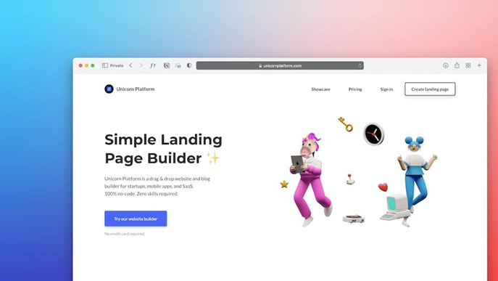
Case Study 1 – Implementation Steps
Persona Development
Journey Mapping
Wireframing
Usability Testing
User Research
(Unicorn Platform 2024)
Notes:
•Step 1: User Research and Testing: Conduct user interviews and surveys to understand pain points. Perform usability testing on the current checkout process to identify specific issues.
•Step 2: Design and Prototyping: Create wireframes and prototypes for the new checkout process. Test the prototypes with users to gather feedback and make improvements.
•Step 3: Development and Integration: Implement the redesigned checkout process on the website. Ensure the new design is fully responsive and includes necessary trust signals.
•Step 4: Continuous Monitoring and Optimization: Monitor user behavior and feedback post-implementation. Continuously make adjustments based on data and user feedback to improve the checkout experience.

Slide 30
Case Study 1 – Expected Outcomes
•Improved User Experience: Simplified navigation and mobile optimization will make the checkout process smoother and more intuitive.
•Increased Conversion Rates: A more efficient and user-friendly checkout process will reduce cart abandonment and increase completed purchases.
•Enhanced Trust and Security: Visible security badges and clear return policies will increase user confidence in the site, reducing drop-off rates.

Slide 31

Case Study 1 - Conclusion and Key Takeaways
Conclusion: The poor UX of ExampleShop.com's checkout process led to high cart abandonment and lost revenue. By simplifying navigation, optimizing for mobile, and increasing trust signals, the site can significantly improve its user experience and conversion rates.
Key Takeaways: Conduct thorough user research to identify pain points. Simplify the checkout process to reduce friction. Ensure mobile responsiveness to capture mobile users. Include trust signals to reassure users about security.

Slide 32
Case Study 2:
A Retail Company

Slide 33

Case Study 2 – A Retail Company
Problem Overview:
  Company: A major retail company
  Challenge: The company’s mobile app was receiving poor user feedback due to its complicated navigation and lengthy checkout process.
What could be a possible strategy they should follow?
Write in the chat box or raise your hand to share your ideas verbally.
Notes:
User Research: Conducted extensive user research including surveys, interviews, and usability testing to identify pain points.
Persona Development: Developed detailed personas representing key user groups to better understand their needs and preferences.
Journey Mapping: Created detailed customer journey maps to visualize the user experience and identify critical touchpoints.
Wireframing and Prototyping: Designed and tested multiple wireframes and prototypes to simplify the navigation and streamline the checkout process.
Usability Testing: Continuously tested the new designs with real users to ensure improvements were effective.

Slide 34
Case Study 2 - Strategy
Persona Development
Journey Mapping
Wireframing
Usability Testing
User Research
Strategy:
Notes:
User Research: Conducted extensive user research including surveys, interviews, and usability testing to identify pain points.
Persona Development: Developed detailed personas representing key user groups to better understand their needs and preferences.
Journey Mapping: Created detailed customer journey maps to visualize the user experience and identify critical touchpoints.
Wireframing and Prototyping: Designed and tested multiple wireframes and prototypes to simplify the navigation and streamline the checkout process.
Usability Testing: Continuously tested the new designs with real users to ensure improvements were effective.

Slide 35
Case Study 2 – Successful UX Strategy
Results:
  Increased Engagement: The improved user interface led to a significant increase in user engagement.
  Sales Boost: The streamlined checkout process resulted in a 20% increase in online sales.
  Customer Satisfaction: Positive user feedback and higher app ratings in app stores.
Key Takeaways and Lessons Learned:
  Simplifying user interactions can dramatically improve user satisfaction and business outcomes.
  Regular usability testing is crucial to ensure that design changes are effectively addressing user needs.
  Understanding the user journey helps in identifying and resolving pain points that affect user experience.
Notes:
User Research: Conducted extensive user research including surveys, interviews, and usability testing to identify pain points.
Persona Development: Developed detailed personas representing key user groups to better understand their needs and preferences.
Journey Mapping: Created detailed customer journey maps to visualize the user experience and identify critical touchpoints.
Wireframing and Prototyping: Designed and tested multiple wireframes and prototypes to simplify the navigation and streamline the checkout process.
Usability Testing: Continuously tested the new designs with real users to ensure improvements were effective.

Slide 36
Group Activity (45 mins)
Notes:
5 mins padlet and breakout room setup
30 mins group discussion
10 min Q/A takeaway discussion

Slide 37
Group Activity – Shoe Factory Owner
Scenario Overview:
  Owner: You are the owner of a small shoe factory specializing in creating comfortable, durable, and stylish shoes for children aged 0 to 7. Your goal is to design a user-friendly website to showcase your products, attract customers, and facilitate easy purchasing.
  Task: Using the 4D Model (Discovery, Definition, Design, Development), create a comprehensive plan for developing the website on the Padlet board.
Notes:
5 mins padlet and breakout room setup
30 mins group discussion
10 min Q/A takeaway discussion

Slide 38
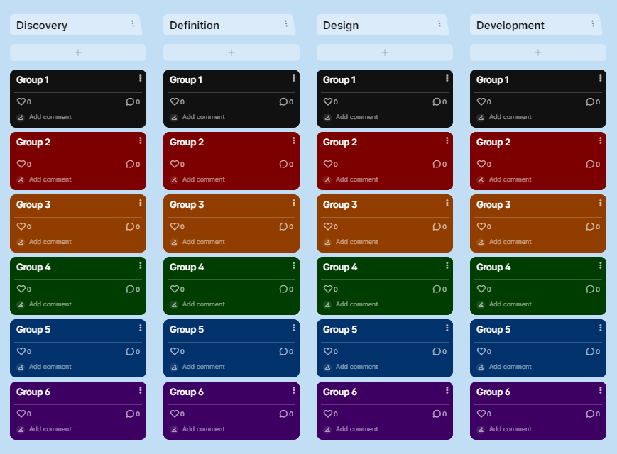
Client Scenario – 30 minutes
Follow the link to the Padlet in the chat box
Go into your breakout session
Discuss your ideas as group
Add your ideas to the board following the 4D model
Notes:
Note for lecturer:
1. Sign in or create an account on Padlet.com using your QA Account.
2. Once you are signed in, click on the following link, https://padlet.com/eleanor_walker/remake-link/8wOpvYk4lW5mz6AY (DO NO SHARE THIS LINK WITH STUDENTS). This link will automatically create a duplicate of a 4D group work board for you.
3. Then, get the sharing link to your newly created duplicate board and when in class, share this with the students in the chat box before they go into their breakout sessions.
4. Follow up with 10 minutes whole class feedback, sharing the Padlet board on screen.

Slide 39
Client Scenario – Shoe Factory Owner (Takeaways)
discovery
definition
design
requirements document
sketches
user journeys
comparative/competitive
review
personas
site map
features/functionality
inventory
user flows
wireframes
experience brief
use cases
prototype
Notes:
These are the outcomes lecturer can show as result of padlet activity.

Slide 40
Summary

Slide 41
Key Takeaways
Key takeaway 1: UX emphasizes the user's journey to solve a problem and the overall feel of the product while UI focuses on the product's visual and interactive elements.
Key takeaway 2: UX strategy is critical for creating products that meet user needs and drive business success. A well-defined UX strategy enhances user satisfaction, loyalty, and overall business performance.
Key takeaway 3: In agile development we must consider different phases and practicalities of 4D
Key takeaway 4: Aligning UX strategy with business goals ensures that user experience improvements directly contribute to achieving business outcomes. Successful UX strategies lead to higher customer retention, increased sales, and a competitive market advantage.

Slide 42
Weekly self-study materials
Reading for this week is …
Read the UX Case Study ‘Bad UX Strategy’ examples here:
Grant, W. (2023) 10 Bad Website Design Examples - Mistakes to Avoid in 2023. [online] iMyFone. Available at: https://www.imyfone.com/web-design/bad-website-design/.
Varhatiuk, K. (2022). 10 Worst User Experience Website Examples. [online] Fireart Studio. Available at: https://fireart.studio/blog/10-worst-user-experience-website-examples/.
You will find a reading activity and a quiz to help you revise this week's contents, both available in the module's VLE.

Slide 43
References
INTERACTION DESIGN FOUNDATION – IxDF, 2020. What is Empathize? [viewed 09 June 2024]. Available from: https://www.interaction-design.org/literature/topics/empathize.
GRANT, W., 2023. 10 Bad Website Design Examples - Mistakes to Avoid in 2023 [viewed 09 June 2024]. Available from: https://www.imyfone.com/web-design/bad-website-design/.
PACHECO, J.F., 2021. Design Thinking the 4D UX methodology. In Juan Fernando Pacheco. [viewed 09 June 2024]. Available from: https://medium.com/juanpacheco/design-thinking-the-4d-ux-methodology-e621adc3339c.
PATEL, N., 2023. 9 Content Marketing Trends to Increase Traffic. In Neil Patel Clog. [viewed 09 June 2024]. Available from: https://neilpatel.com/blog/content-marketing-trends/.
SKILLSFUTURE, 2021a. What if we designed with UX/UI in mind? [viewed 09 June 2024]. Available from: https://www.skillsfuture.gov.sg/resources.
SKILLSFUTURE, 2021b. Design Thinking: Do I Need it for my Business? [viewed 09 June 2024]. Available from: https://www.skillsfuture.gov.sg/resources.
SOEGAARD, M., 2024a. Design Thinking: Top Insights from the IxDF Course. In The Interaction Design Foundation. [viewed 09 June 2024]. Available from: https://www.interaction-design.org/literature/article/learn-from-ixdf-design-thinking-course.
SOEGAARD, M., 2024b. UX vs. UI: What’s the Difference? In The Interaction Design Foundation. [viewed 09 June 2024]. Available from: https://www.interaction-design.org/literature/article/ux-vs-ui-what-s-the-difference.
S., K., 2020. The Design Thinking Process - How does it work?. In MAQE. [viewed 09 June 2024]. Available from: https://www.maqe.com/insight/the-design-thinking-process-how-does-it-work/.
UNICORN PLATFROM, 2024. Unicorn Platform [viewed 09 June 2024]. Available from: https://unicornplatform.com/
VARHATIUK, K., 2022. 10 Worst User Experience Website Examples. In Fireart Studio. [viewed 09 June 2024]. Available from: https://fireart.studio/blog/10-worst-user-experience-website-examples/.
WEERASINGHE, S., 2018. User Experience Design – A Head Start based on my view. In LinkedIn Pulse. [viewed 09 June 2024]. Available from: https://www.linkedin.com/pulse/user-experience-design-head-start-based-my-view-shakthi-weerasinghe/.

